Slide 1
Emerging Technologies for the Circular Economy
Lecture 3: Circular Economy II
Prof. Dr. Benjamin Leiding (Clausthal)
M.Sc. Arne Bochem (Göttingen)
M.Sc. Anant Sujatanagarjuna (Clausthal)
Notes:
<number>

Slide 2
License
This work is licensed under a Creative Commons Attribution-ShareAlike 4.0 International License. To view a copy of this license, please refer to https://creativecommons.org/licenses/by-sa/4.0/ .
Updated versions of these slides will be available in our Github repository.

Slide 3
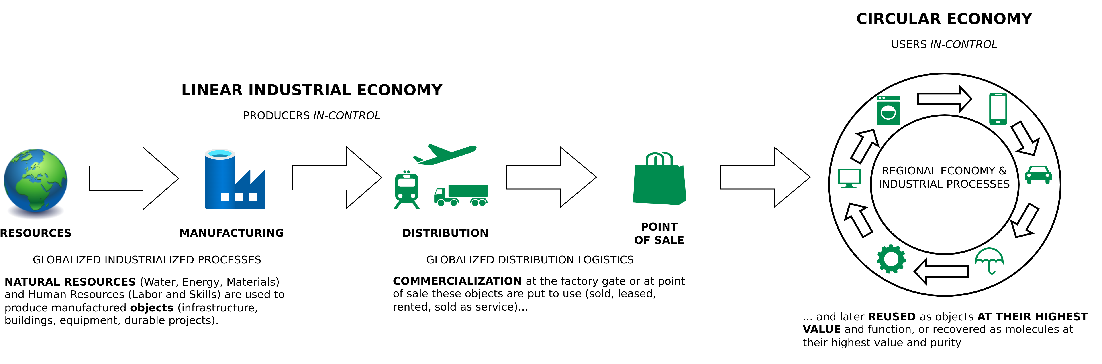
The Linear (Industrial) Economy
Image adapted from: Walter R. Stahel (2019) – The Circular Economy: A User’s Guide.

Slide 4
Circular Economy
Center for Digital Technologies (DIGIT) (2022) – https://www.digit-research.de/fileadmin/DIGIT/Presse_und_News/Downloads/Grafikpaket_Reallabor_DCE_Kreislaufmodell_V2_ccby.zip – CC BY 4.0.

Slide 5
Example 2 – Electric Vehicle Life Cycle Assessment (LCA)

Slide 6

LCA – Motivation

Slide 7
LCA – Motivation
Battery Electric Vehicles (EV)
Or
Internal Combustion Engine Vehicles

Slide 8
Material Flow
„A material flow is the path of a material from its extraction as a raw material through the various stages of refinement to the final product stage, the use/consumption of the product, and - if applicable - its reuse/recovery up to its disposal.”
Deutscher Bundestag (1994): Bericht der Enquete-Kommission „Schutz des Menschen und der Umwelt − Bewertungskriterien und Perspektiven für umweltverträgliche Stoffkreisläufe in der Industriegesellschaft". Deutscher Bundestag. Bonn (Drucksache, 12/8260).

Slide 9
Material Flow Management
„Material flow management is the goal-oriented, efficient use of materials, material streams and energy. The goals are given by ecological and economical areas and by observing social aspects.”
Deutscher Bundestag (1994): Bericht der Enquete-Kommission „Schutz des Menschen und der Umwelt − Bewertungskriterien und Perspektiven für umweltverträgliche Stoffkreisläufe in der Industriegesellschaft". Deutscher Bundestag. Bonn (Drucksache, 12/8260).

Slide 10
Material Flow Analysis (MFA)
Which material flows are relevant?
Deutscher Bundestag (1994): Bericht der Enquete-Kommission „Schutz des Menschen und der Umwelt − Bewertungskriterien und Perspektiven für umweltverträgliche Stoffkreisläufe in der Industriegesellschaft". Deutscher Bundestag. Bonn (Drucksache, 12/8260).

Slide 11
Material Flow Analysis (MFA)
Which material flows are relevant?
In which processes and by which actors are these materials used?
Deutscher Bundestag (1994): Bericht der Enquete-Kommission „Schutz des Menschen und der Umwelt − Bewertungskriterien und Perspektiven für umweltverträgliche Stoffkreisläufe in der Industriegesellschaft". Deutscher Bundestag. Bonn (Drucksache, 12/8260).

Slide 12
Material Flow Analysis (MFA)
Which material flows are relevant?
In which processes and by which actors are these materials used?
In what quantities are the materials used, extracted from the environment and discharged into the environment?
Deutscher Bundestag (1994): Bericht der Enquete-Kommission „Schutz des Menschen und der Umwelt − Bewertungskriterien und Perspektiven für umweltverträgliche Stoffkreisläufe in der Industriegesellschaft". Deutscher Bundestag. Bonn (Drucksache, 12/8260).

Slide 13
Life Cycle Assessment (LCA)
The life cycle assessment is an instrument that allows for a holistic, systematic recording of environmental impacts and an evaluation of a balance object in order to enable the comparison of alternatives. Balance objects can be products, processes, companies or behaviors.
Bieletzke (1999): Simulation der Ökobilanz – Modelltheoretische Analyse ökonomischer und ökologischer Auswirkungen

Slide 14
MFA vs. LCA

Slide 15
MFA vs. LCA
MFA is a component of the LCA

Slide 16
MFA vs. LCA
MFA is a component of the LCA
MFA explicitly does not include any environmental assessment

Slide 17
MFA vs. LCA
MFA is a component of the LCA
MFA explicitly does not include any environmental assessment
MFA is for the qualitative and quantitative assessment of material flows, while in the LCA is additionally performed the environmental assessment through the quantification of environmental effects

Slide 18
LCA – Motivation
Battery Electric Vehicles (EV)
Or
Internal Combustion Engine Vehicles

Slide 19
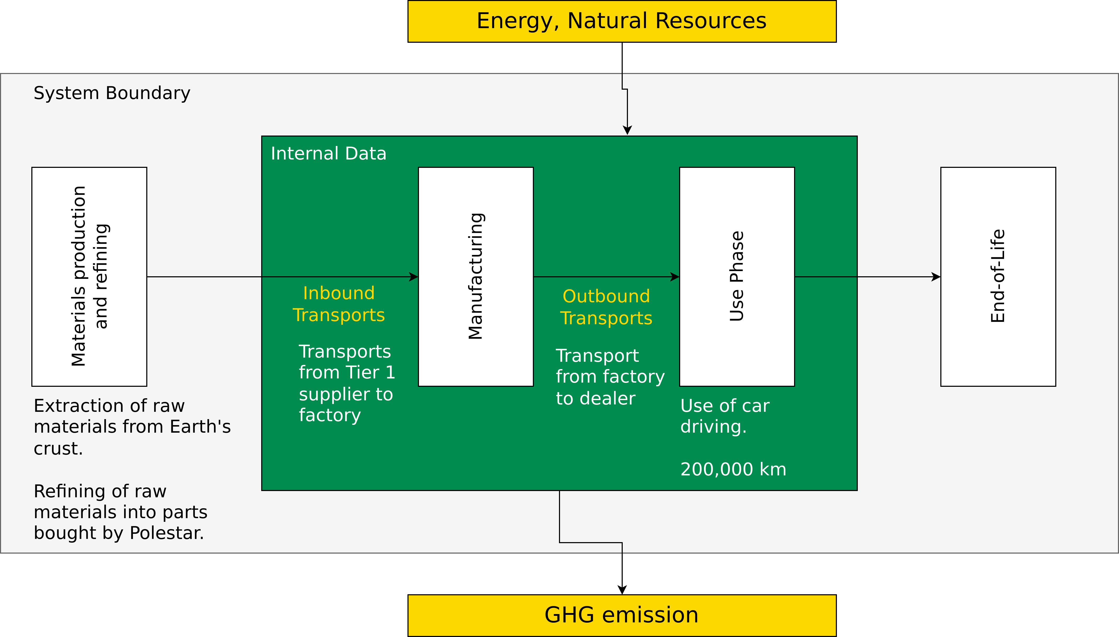
Life Cycle Assessment – Polestar 2
Polestar (2020) – Life Cycle Assessment – Carbon Footprint of Polestar 2.

Slide 20
EV Break-Even Point?
0 – 50.000km
50.000 – 100.000km
100.000 – 150.000km
150.000 – 200.000km
After 200.000km
What is the break-even point (in km) after which an EV would have caused fewer emissions than an Internal Combustion Engine (ICE?)

Slide 21
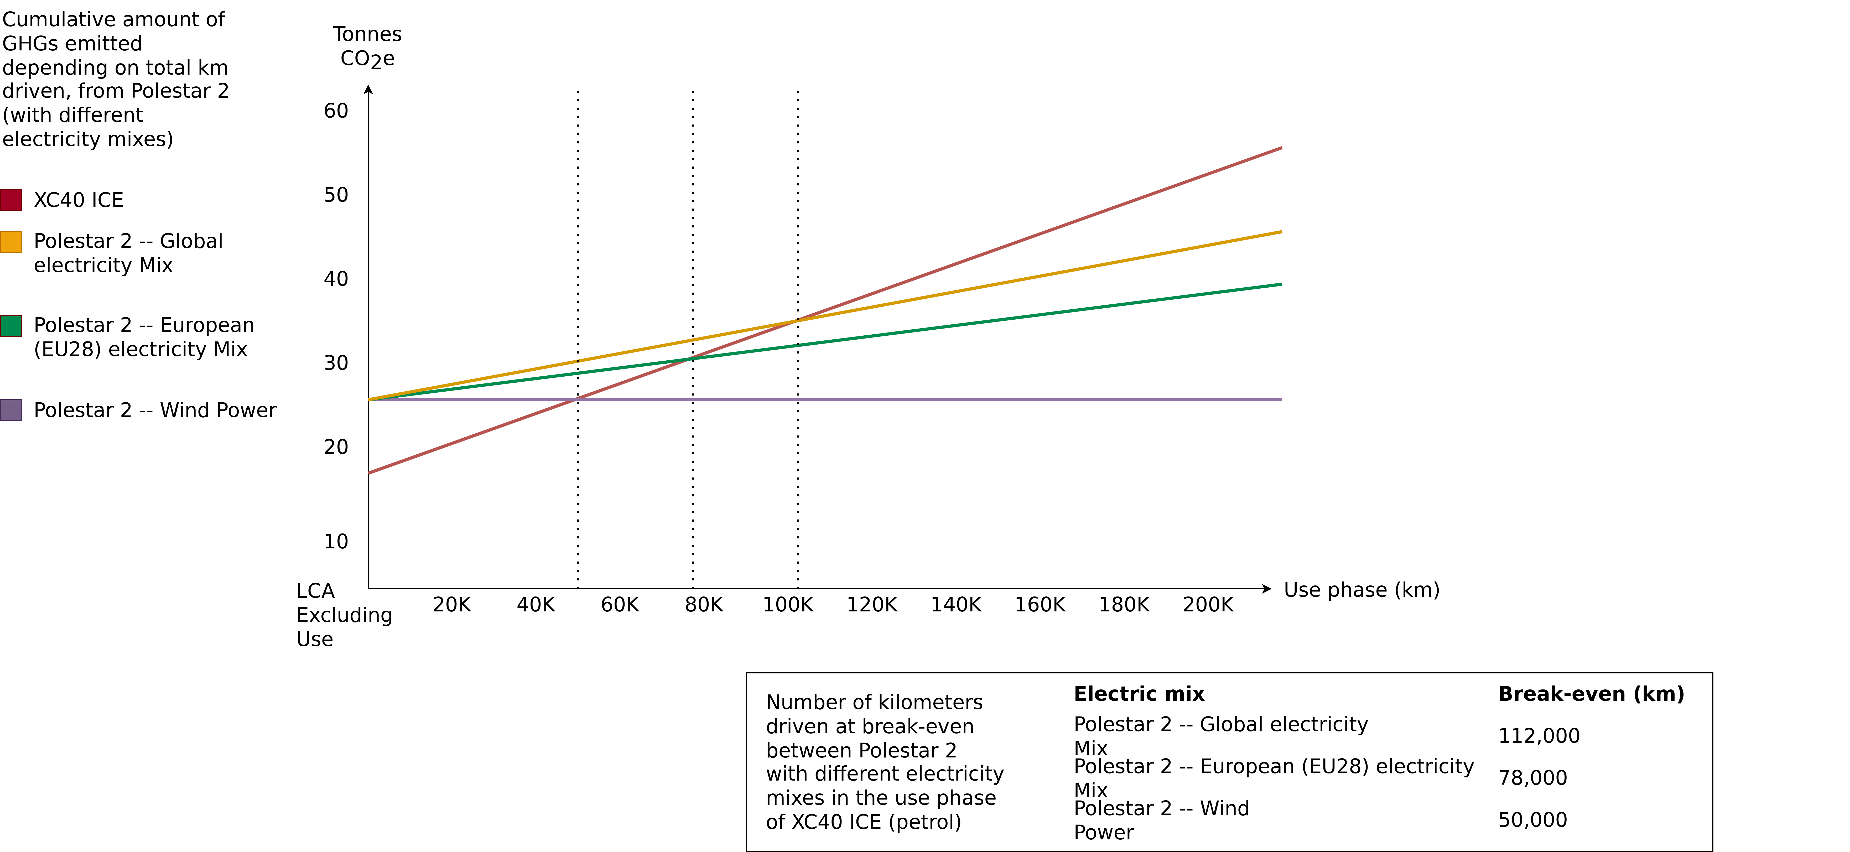
Life Cycle Assessment – Polestar 2
Polestar (2020) – Life Cycle Assessment – Carbon Footprint of Polestar 2.

Slide 22
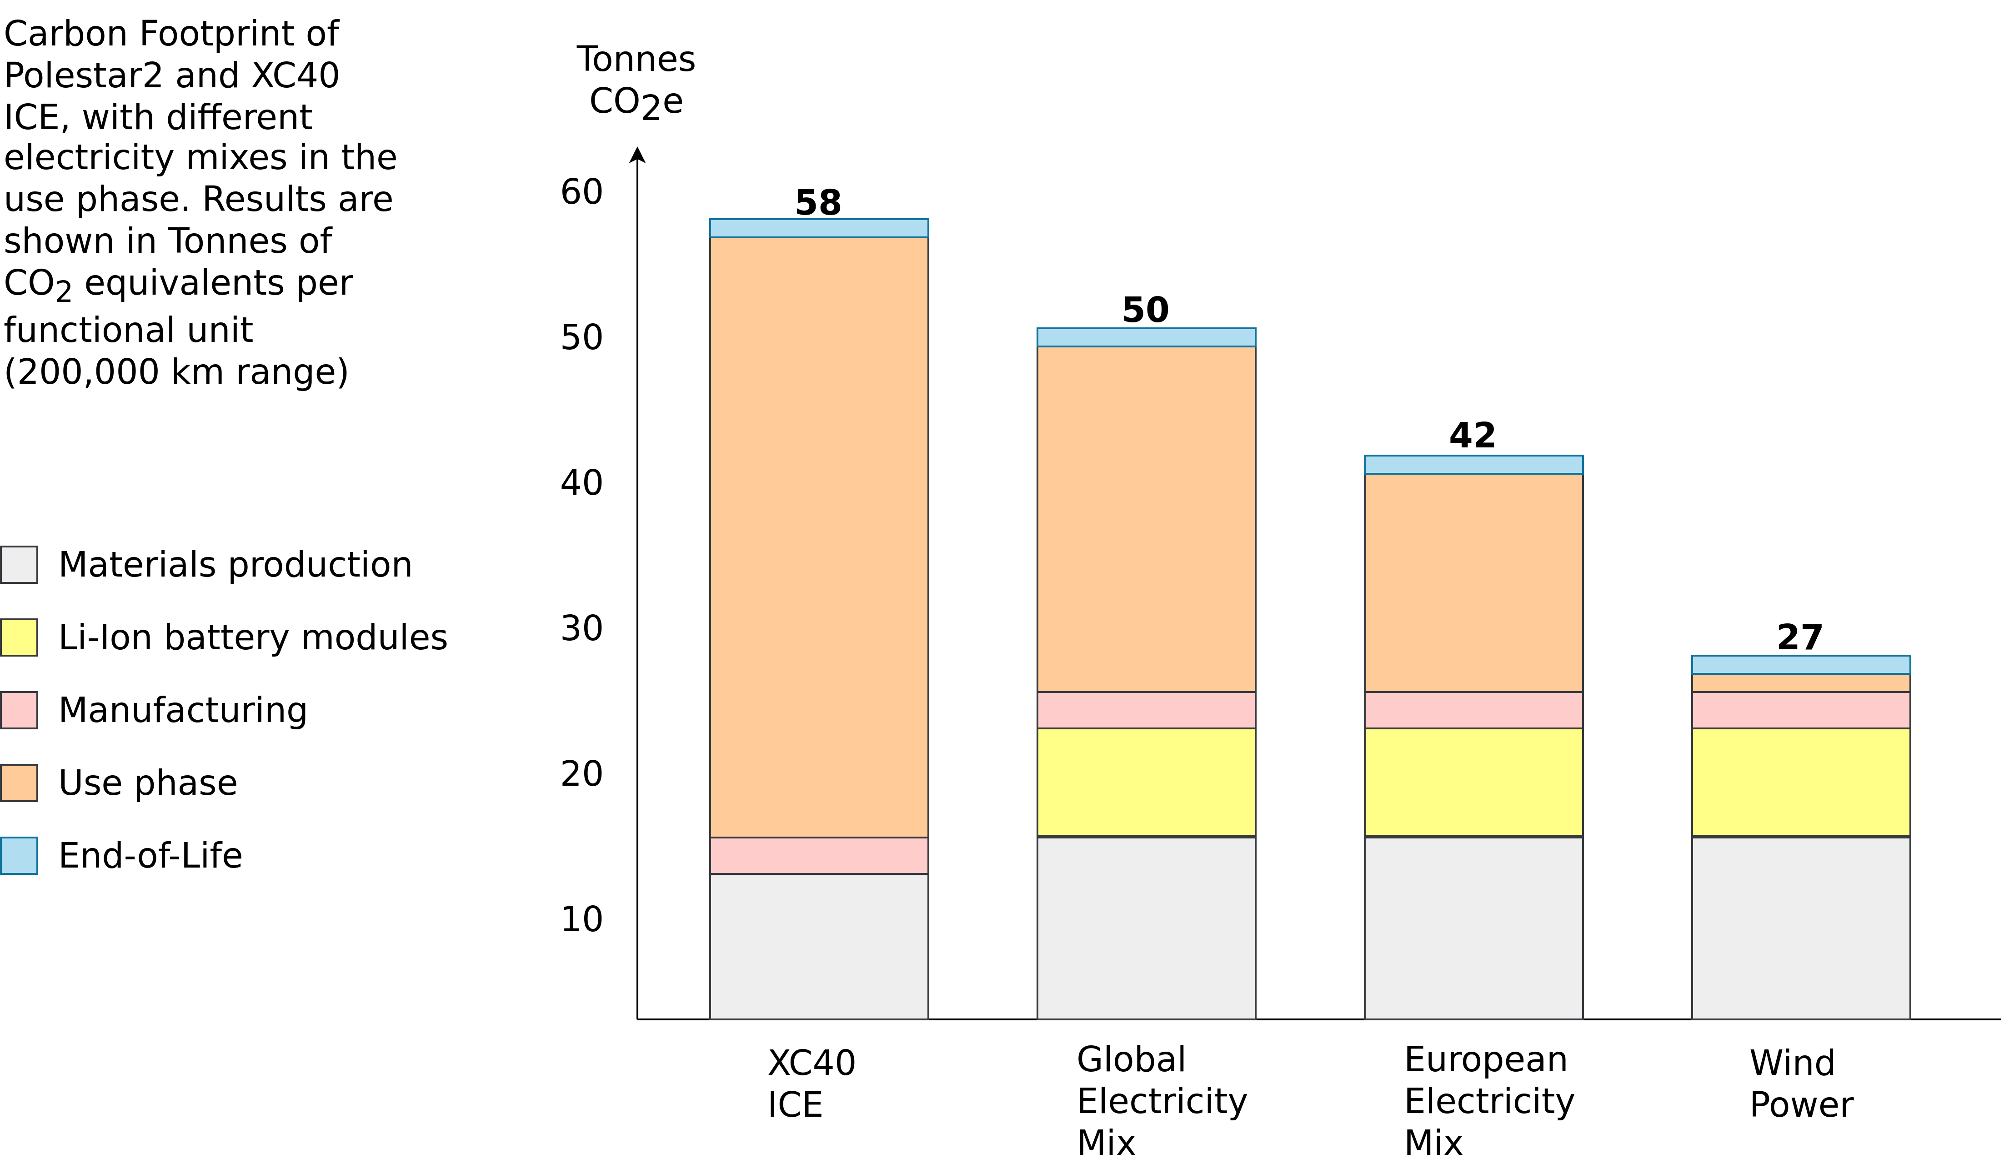
Life Cycle Assessment – Polestar 2
Polestar (2020) – Life Cycle Assessment – Carbon Footprint of Polestar 2.

Slide 23
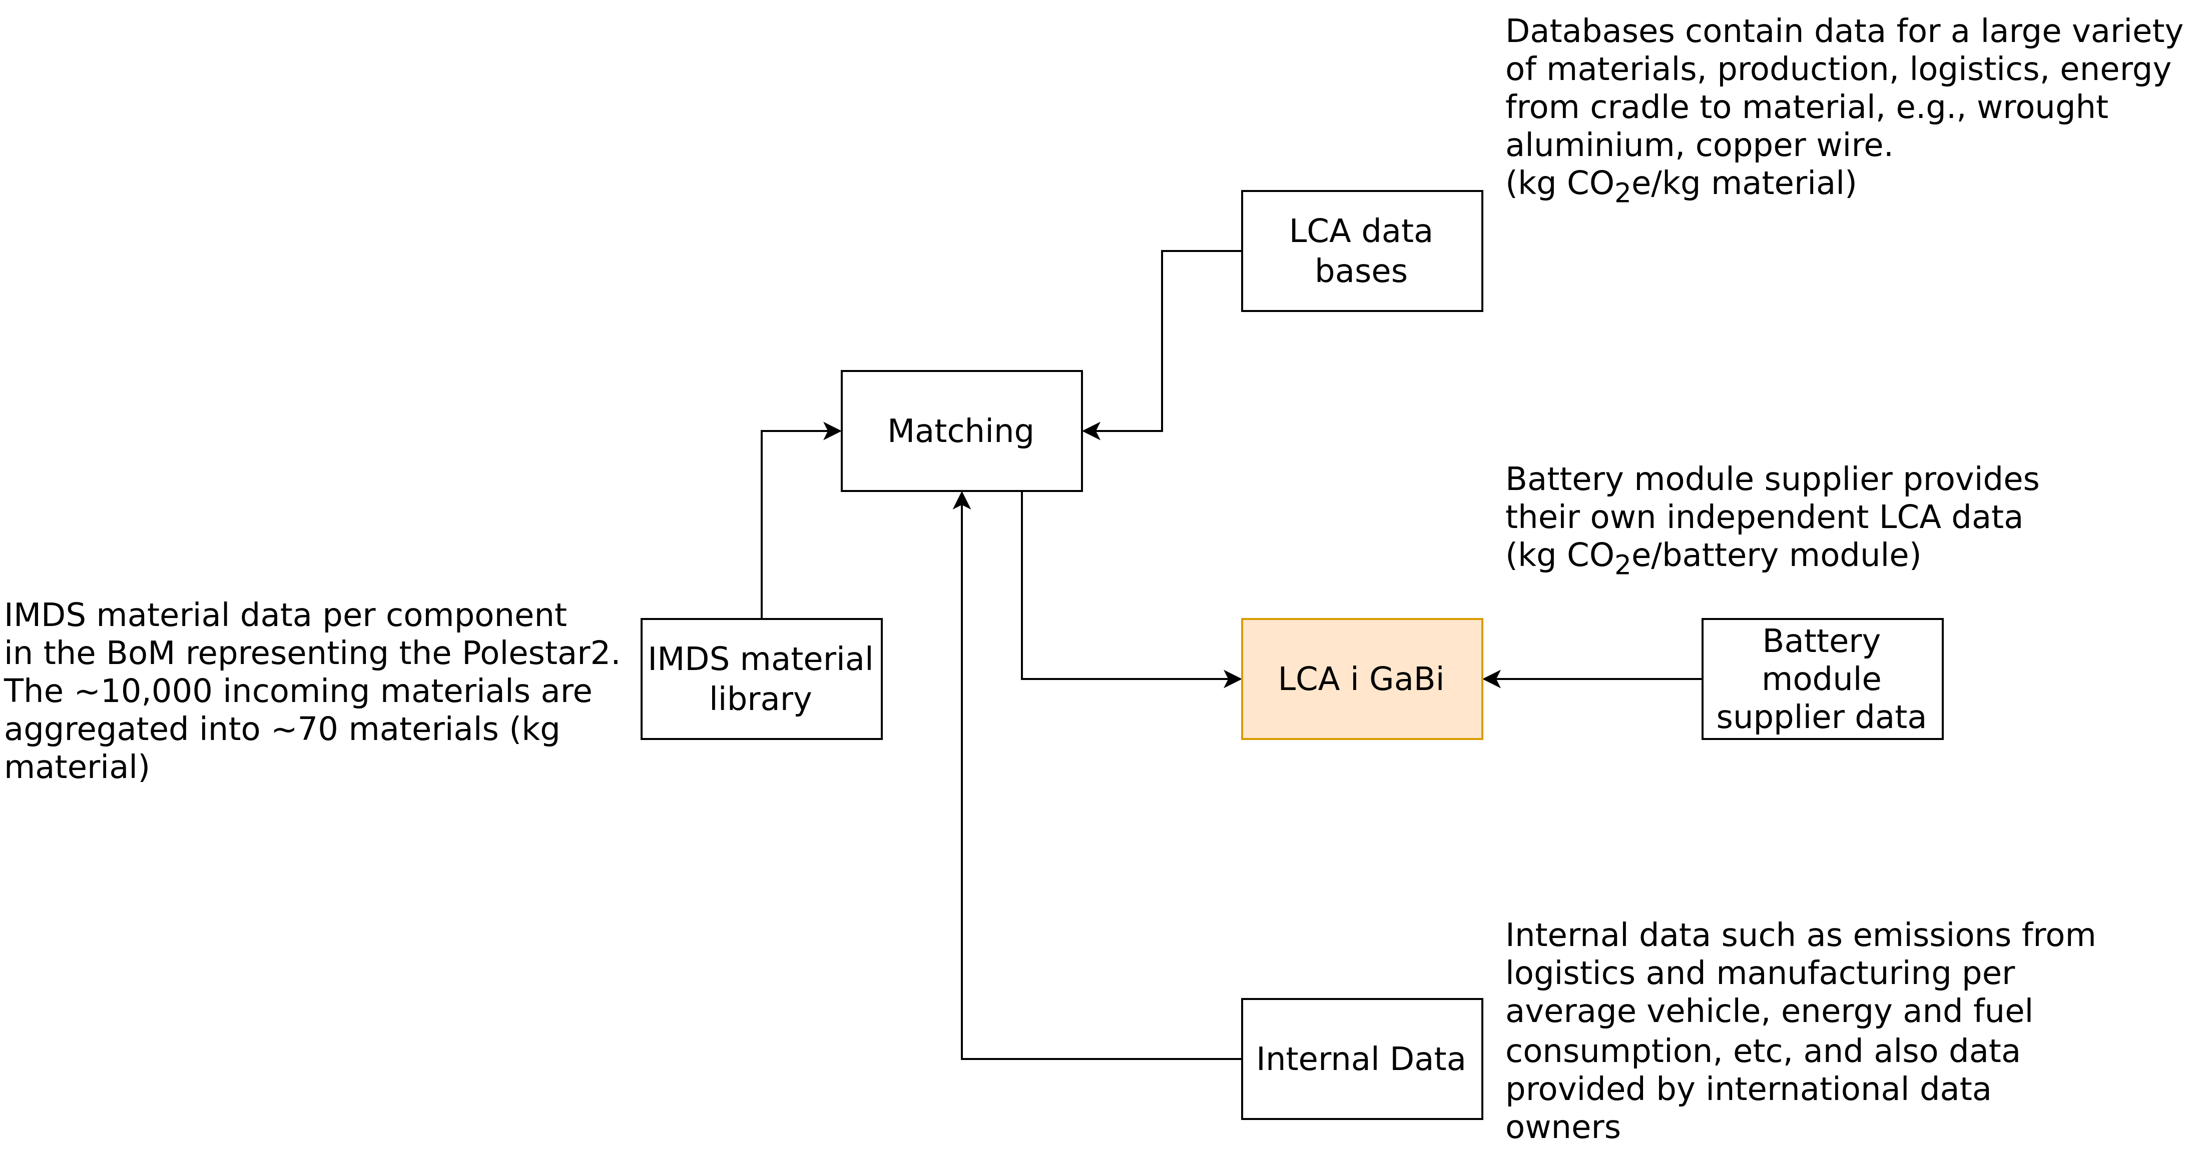
Life Cycle Assessment – Polestar 2
Polestar (2020) – Life Cycle Assessment – Carbon Footprint of Polestar 2.

Slide 24
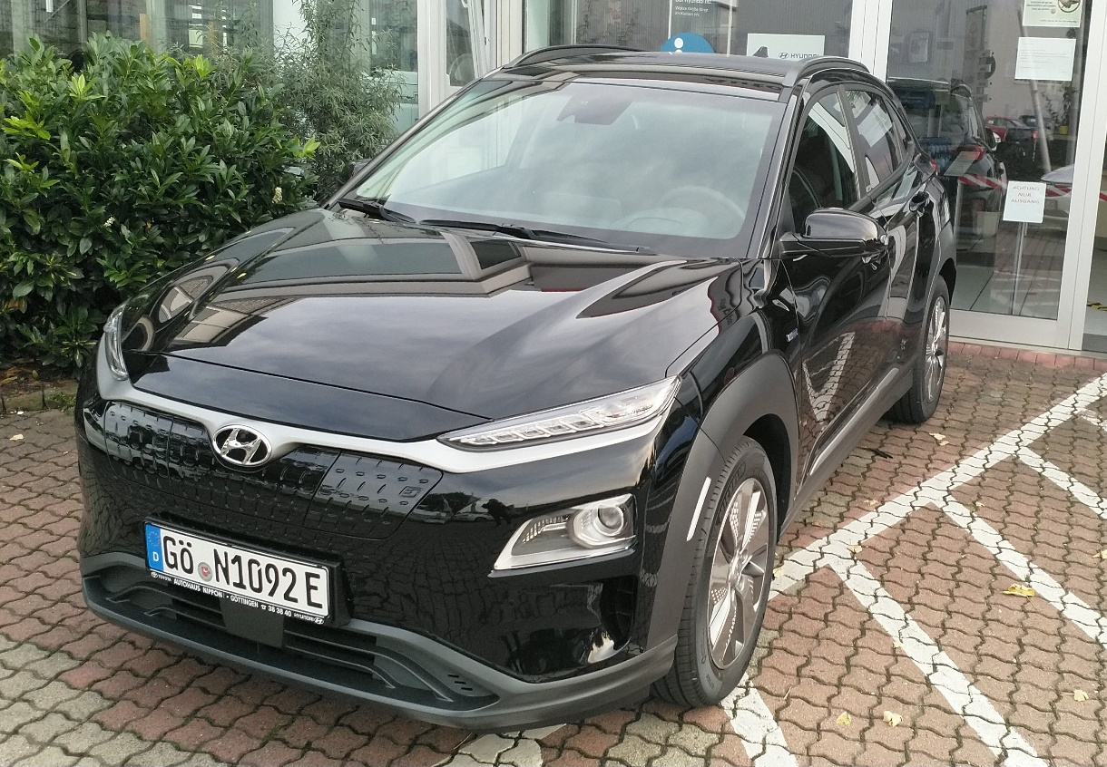
LCA – Result

Slide 25
Critical Discussion
Example LCA based on a report by Polestar → Polestar produces EVs → biased?
Various studies indicate varying numbers with respect to the CO2 footprint of EVs and internal combustion engine cars, especially in the context of LCAs
Therefore:
Check who authors/funds these studies
What are their interests?
Be critical – also while listening to us ;)
Further literature:
Determining the environmental impacts of conventional and alternatively fuelled vehicles through LCA (2020) – European Commission – Link
TU-Eindhoven report – Link
Polestar report – Link
BMU (Federal Ministry for the Environment, Nature Conservation and Nuclear Safety) report – Link
Bus case study Romania – Link
RWTH Aachen (synthetic fuels) – Link

Slide 26
Critical Discussion
Example LCA based on a report by Polestar → Polestar produces EVs → biased?
Various studies indicate varying numbers with respect to the CO2 footprint of EVs and internal combustion engine cars, especially in the context of LCAs
Therefore:
Check who authors/funds these studies
What are their interests?
Be critical – also while listening to us ;)
Further literature:
Determining the environmental impacts of conventional and alternatively fuelled vehicles through LCA (2020) – European Commission – Link
TU-Eindhoven report – Link
Polestar report – Link
BMU (Federal Ministry for the Environment, Nature Conservation and Nuclear Safety) report – Link
Bus case study Romania – Link
RWTH Aachen (synthetic fuels) – Link

Slide 27
Critical Discussion
Example LCA based on a report by Polestar → Polestar produces EVs → biased?
Various studies indicate varying numbers with respect to the CO2 footprint of EVs and internal combustion engine cars, especially in the context of LCAs
Therefore:
Check who authors/funds these studies
What are their interests?
Be critical – also while listening to us ;)
Further literature:
Determining the environmental impacts of conventional and alternatively fuelled vehicles through LCA (2020) – European Commission – Link
TU-Eindhoven report – Link
Polestar report – Link
BMU (Federal Ministry for the Environment, Nature Conservation and Nuclear Safety) report – Link
Bus case study Romania – Link
RWTH Aachen (synthetic fuels) – Link

Slide 28
Example 3 – Digital Twins

Slide 29
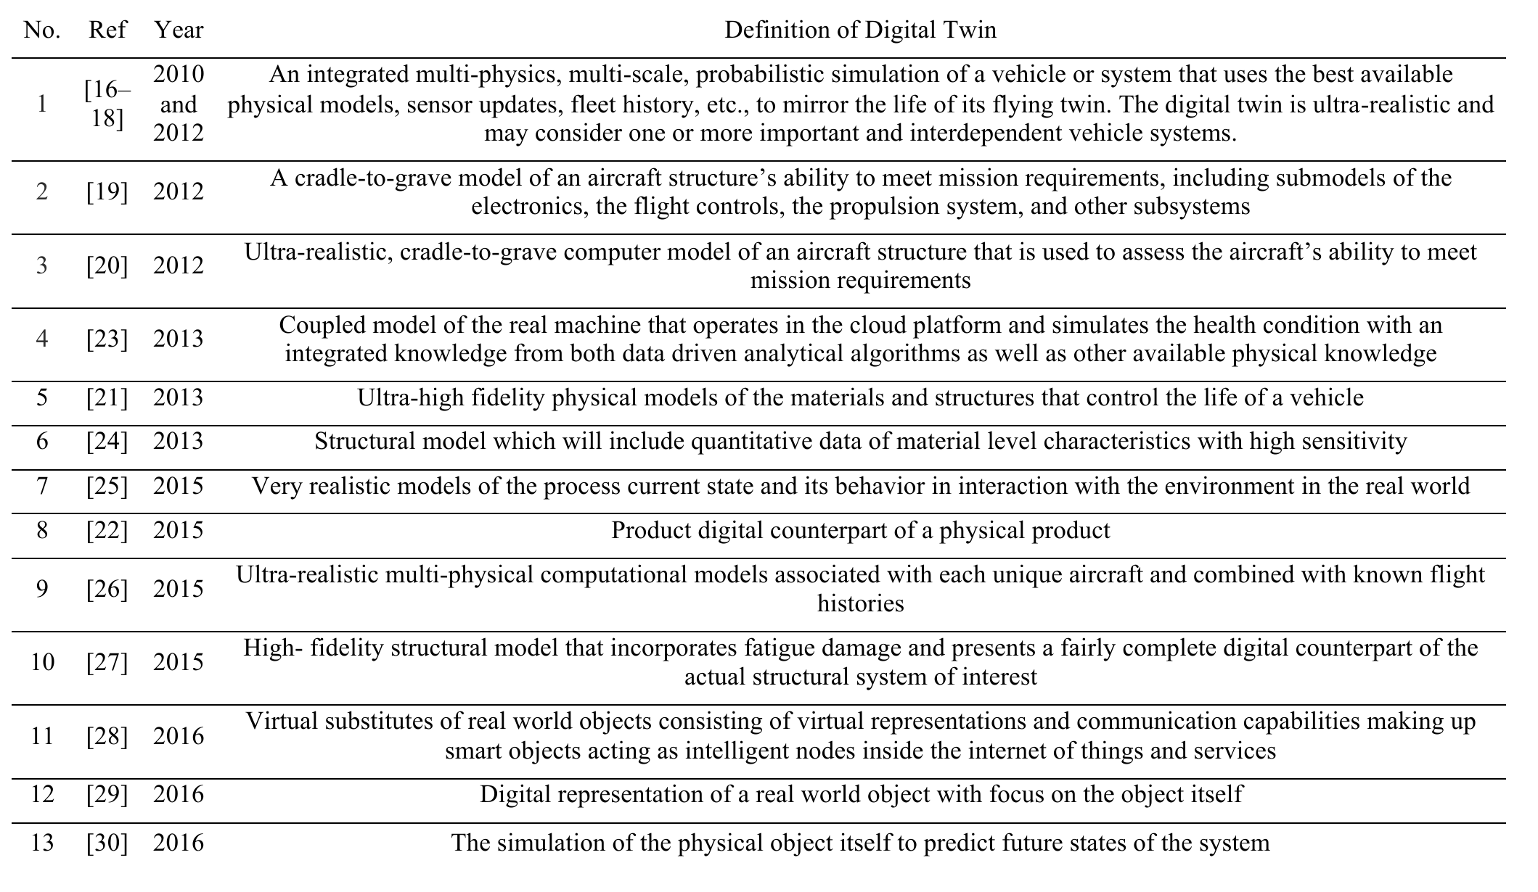
Definitions
Negri et al. (2017) – A Review of the Roles of Digital Twin in CPS-based Production Systems – https://doi.org/10.1016/j.promfg.2017.07.198.

Slide 30
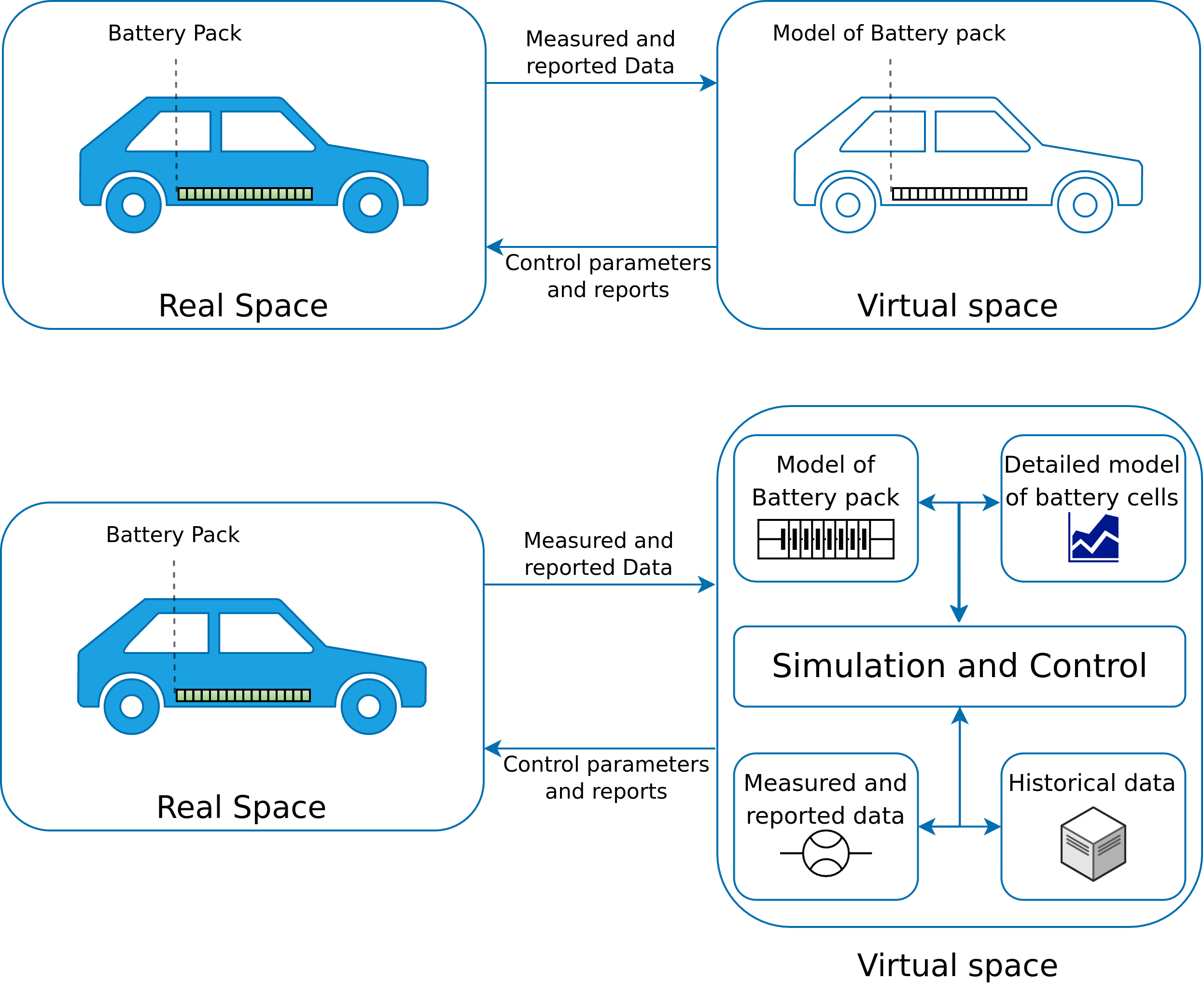
Example 1: Automotive Industry
The digital twin concept exemplified on a battery pack of a BEV.
Image adapted for BEVs from https://www.comsol.com/blogs/digital-twins-not-just-hype/
Notes:
<number>

Slide 31
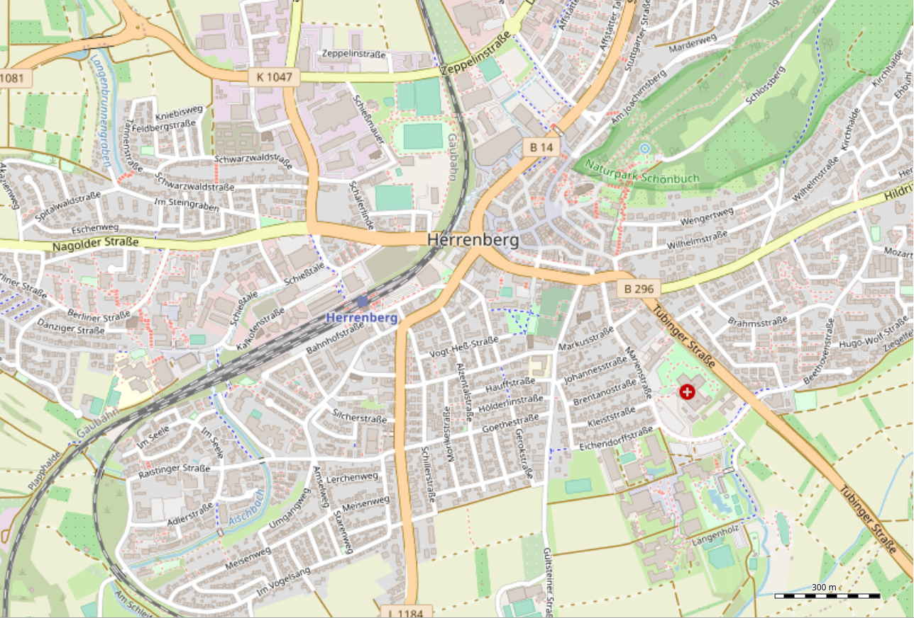
Example 2: Smart Cities
Digital Twin of Herrenberg
Mathematical street network model with space syntax
Used to indicate high/low potentials of traffic.
Sensor network
Temperature
Humidity
Particulate Matter
Air-flow simulation
Simulation and combination of data relates emissions to potential volume of traffic using wind, humidity, temperature and particulate matter data.
3D Visualization of the above using Virtual Reality (VR)
© OpenStreetMap contributors
Dembski, Fabian, et al. "Urban digital twins for smart cities and citizens: the case study of Herrenberg, Germany." Sustainability 12.6 (2020): 2307
Notes:
<number>

Slide 32
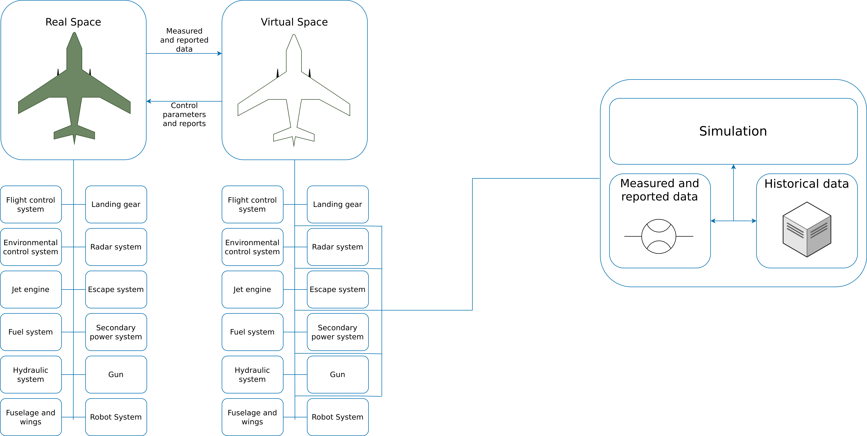
Example 3: Aviation and Aerospace
The figure shows some of the most important subsystems in a fighter jet. A digital twin consists of many different subspaces containing models, simulation data, measured data, and reports for each of the subsystems of the airplane
Image recreated from: https://www.comsol.com/blogs/digital-twins-not-just-hype/
Notes:
-The world’s largest aerospace company Boeing uses a Digital Twin solution for the development of its commercial and military airplanes aimed at improving their quality and safety.
<number>

Slide 33
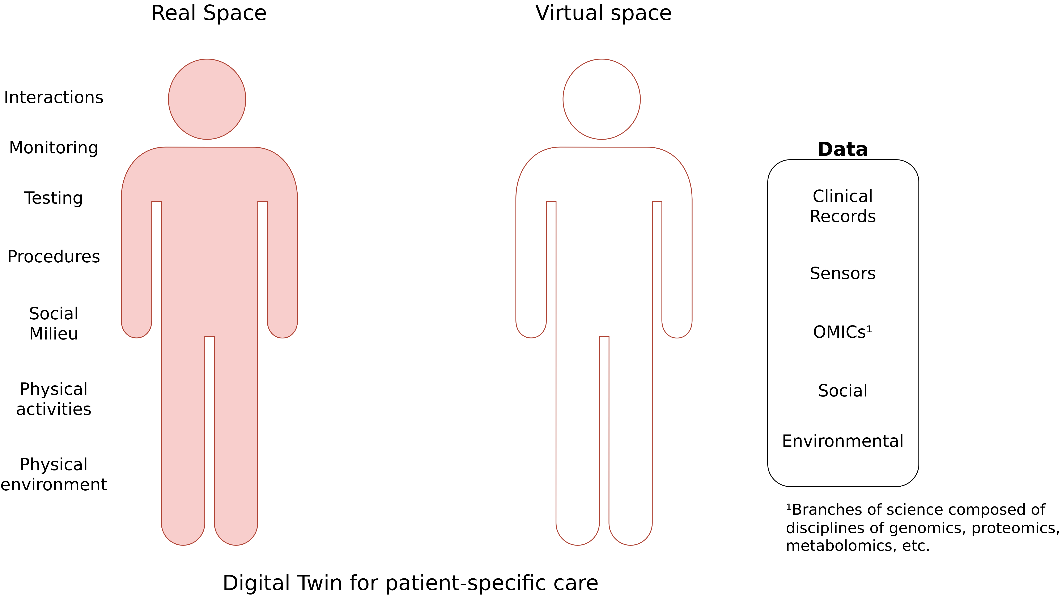
Example 4: Human Medicine
Image adapted from: Rao, Dattaraj Jagdish, and Shraddha Mane. "Digital Twin approach to Clinical DSS with Explainable AI." arXiv preprint arXiv:1910.13520 (2019).
Notes:
<number>

Slide 34
Digital Twins vs. Other Concepts
Digital twins are often compared to be synonymous with simulation, prototype, IoT, etc.
Digital Twin
Simulation
IoT
Prototype's
Notes:
Internet of Things (IoT) defines hundreds of millions of devices that can be connected and controlled via the internet.
On the other hand, digital twin is a virtual replica of an object, system, process, product or service that is digitalized and put on a simulation platform. Digital Twinning, is called a process that involves creating and building a reality-based entity on an online platform. Unlike Internet of Things that must meet the criteria of being able to connect to the Internet and be controlled, a virtual twin can be anything you can imagine.
<number>

Slide 35
Circular Economy
Center for Digital Technologies (DIGIT) (2022) – https://www.digit-research.de/fileadmin/DIGIT/Presse_und_News/Downloads/Grafikpaket_Reallabor_DCE_Kreislaufmodell_V2_ccby.zip – CC BY 4.0.

Slide 36
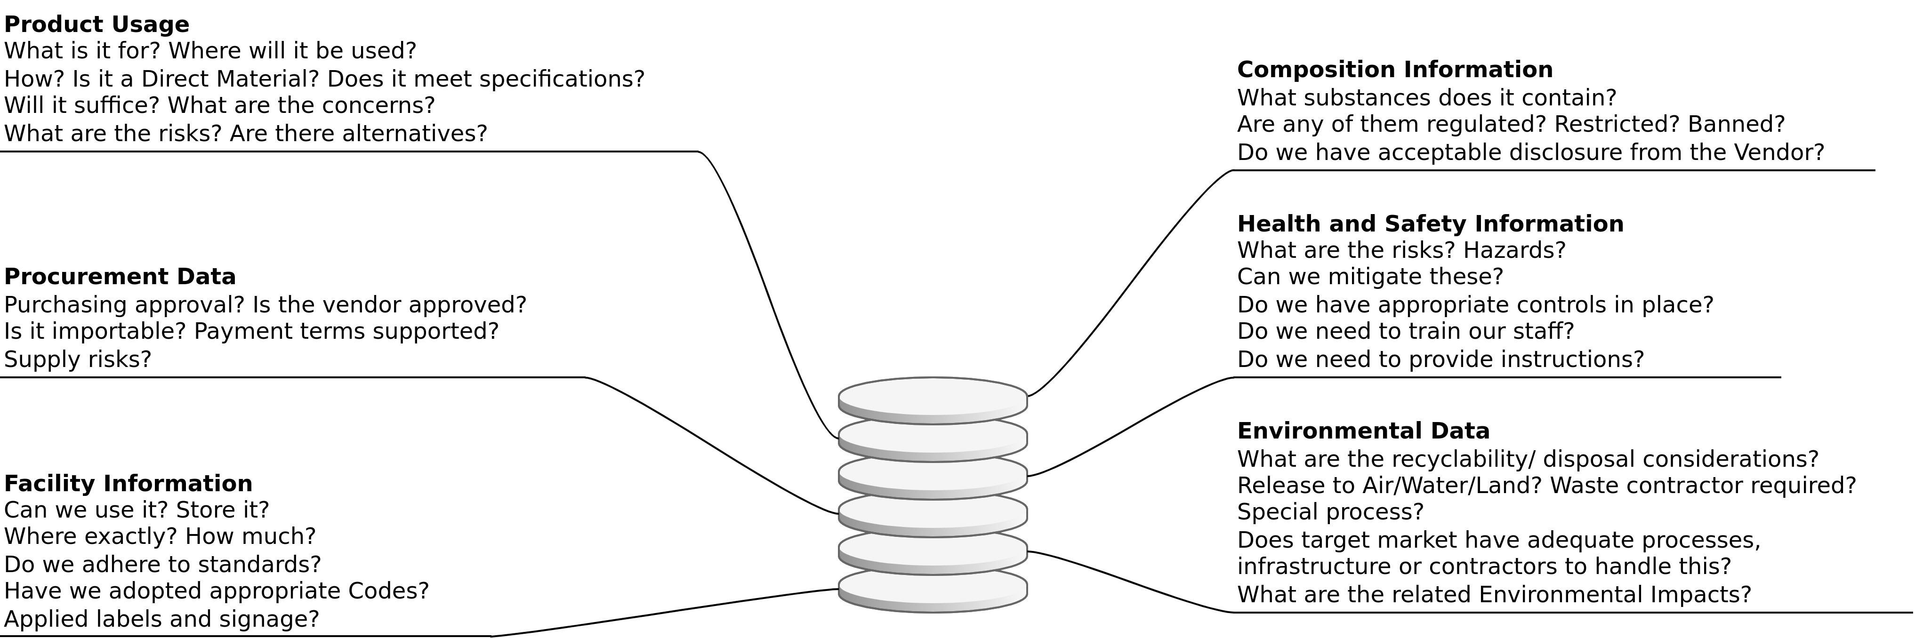
Use Cases (1): Supply Chain Transparency
Relevant Information can be gathered, updated and accessed via a digital twin. Thus creating transparency and traceability.
Based on https://fslci.org/wp-content/uploads/2018/Slides/Sessions/Session_5_Prox.pdf

Slide 37
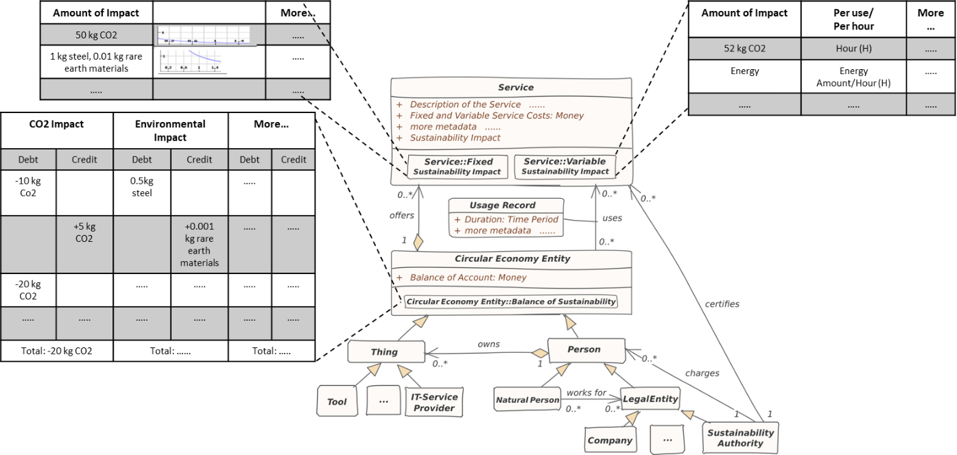
Use Cases (2): Sustainability Impact Factor
Sustainable Ecosystems Engineering Research Group – ISSE TU Clausthal

Slide 38





Use Case (3): Increasing the Longevity of Electronics
Lifecycle data
Scenario 1 – Resell
Buyers can access data from the twin and determine if the laptop/product will serve their requirements.
Data transmission
Process data
laptop
Data transmission
Digital twin of the laptop
Scenario 2 - Repair
Repairers can access the twins data to determine the problem, rather then analyze it by themselves. This would save the repair time and cost.
More Transparency, reducing repair costs and traceability, products could be easily leased or shared

Slide 39
Use Case (4): Battery Electric Vehicles
The digital twin concept exemplified on a battery pack of a BEV.
Image adapted for BEVs from https://www.comsol.com/blogs/digital-twins-not-just-hype/
Notes:
<number>

Slide 40
Example 4 – The Hitchhiker’s Guide to the End-of-Life for Smart Devices

Slide 41
E-Waste at home – Why?
No e-waste at home.
Inconvenient disposal process.
Might need it later (backup solution).
Not sure how to dispose of the e-waste.
Other

Slide 42
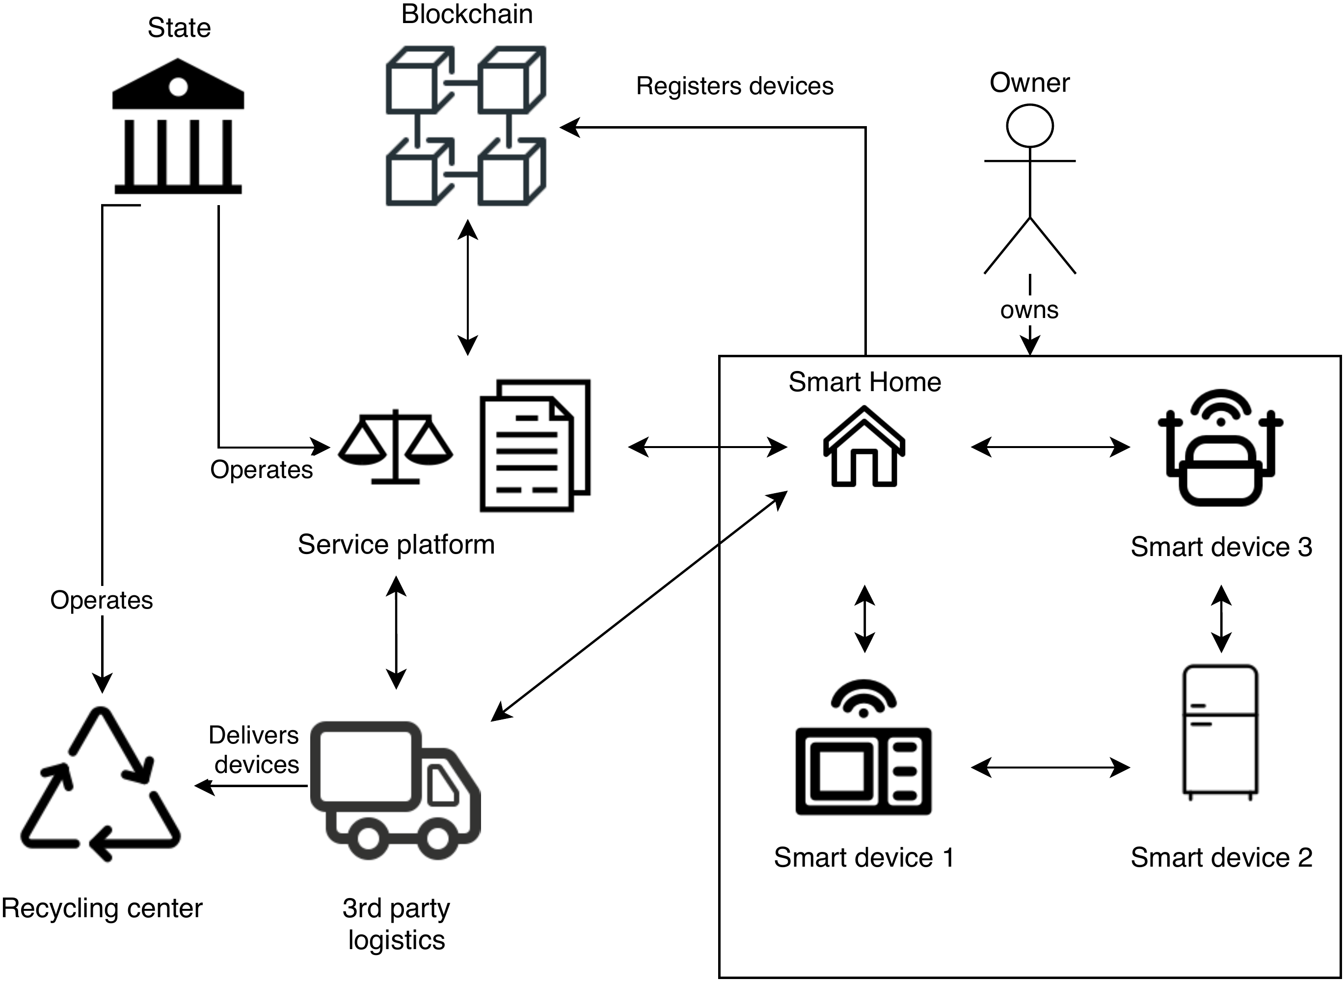
Hitchhiking for E-Waste
S. Lawrenz and B. Leiding (2021) – The Hitchhiker’s Guide to the End-of-Life for Smart Devices

Slide 43
Example 5 – Resell?

Slide 44
Resell and Reuse of IT Devices
Momox.co.uk
Ebay-Kleinanzeigen.de
Rebuy.de
https://www.ebay-kleinanzeigen.de
https://www.momox.co.uk
https://www.rebuy.de

Slide 45
Example 6 – Future Resources

Slide 46
Buildings as Material Banks (BAMB)
Integrating “materials passports” with reversible building design to optimise Circular Industrial Value Chains.
Aims of BAMB:
Prevention of construction and demolition waste.
Reduction of virgin resource consumption and the development towards a circular economy through industrial symbiosis.
Addressing the challenges mentioned in the Work Programme on Climate action, environment, resource efficiency and raw materials
https://cordis.europa.eu/project/id/642384

Slide 47
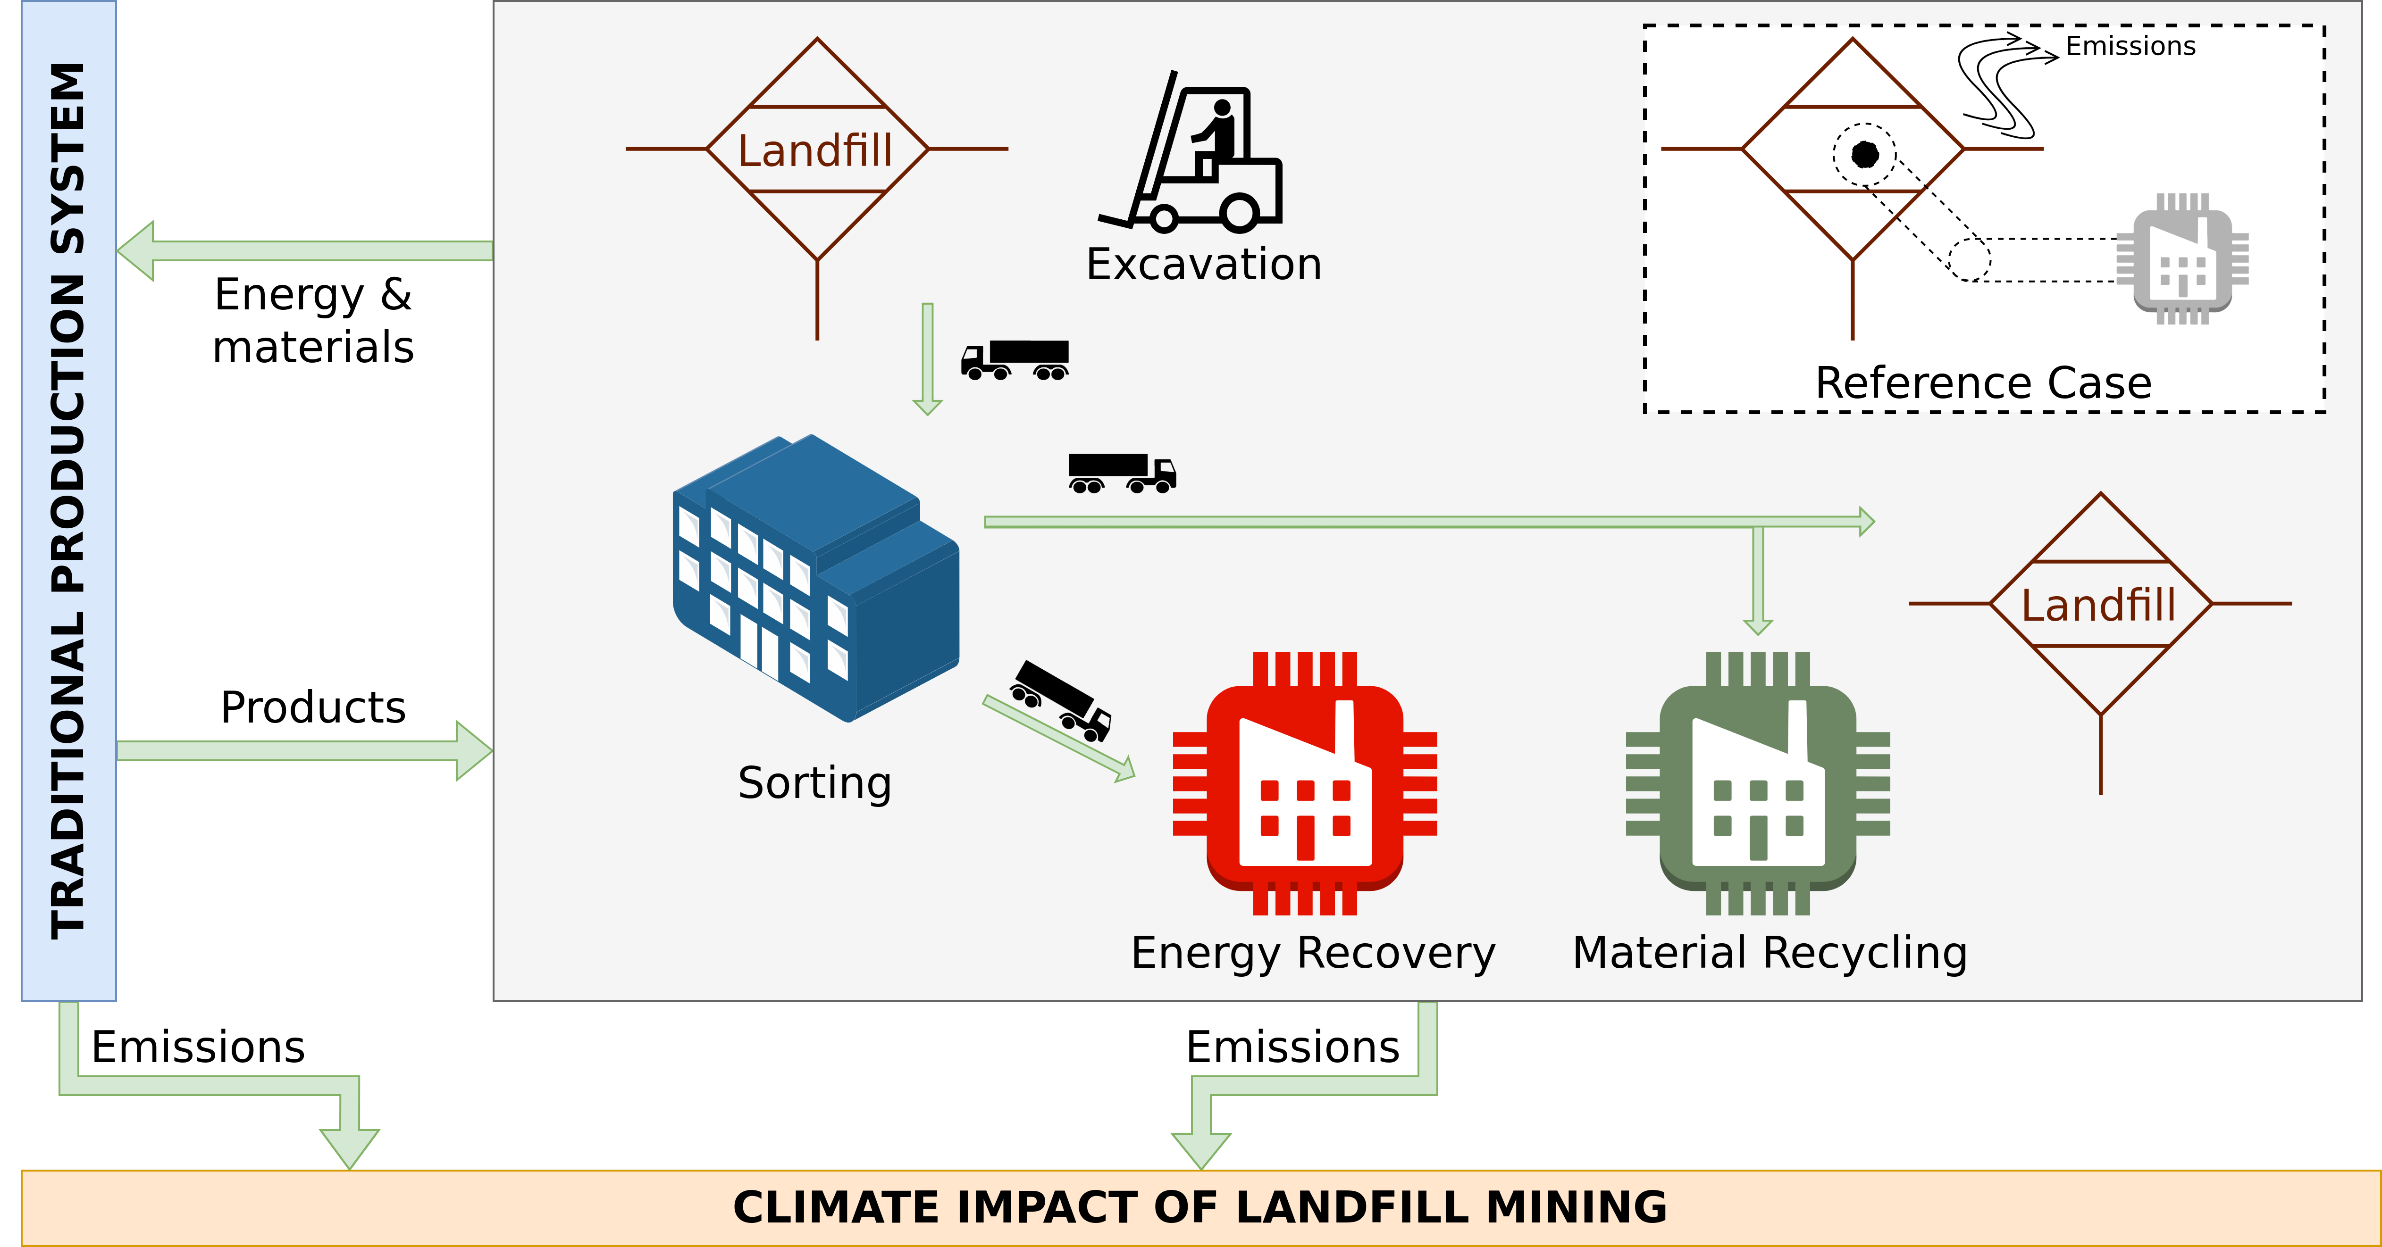
Landfill Mining
Laner et al. (2016) – Quantitative Analysis of Critical Factors for the Climate Impact of Landfill Mining

Slide 48
Digital Circular Economy and Business Models

Slide 49
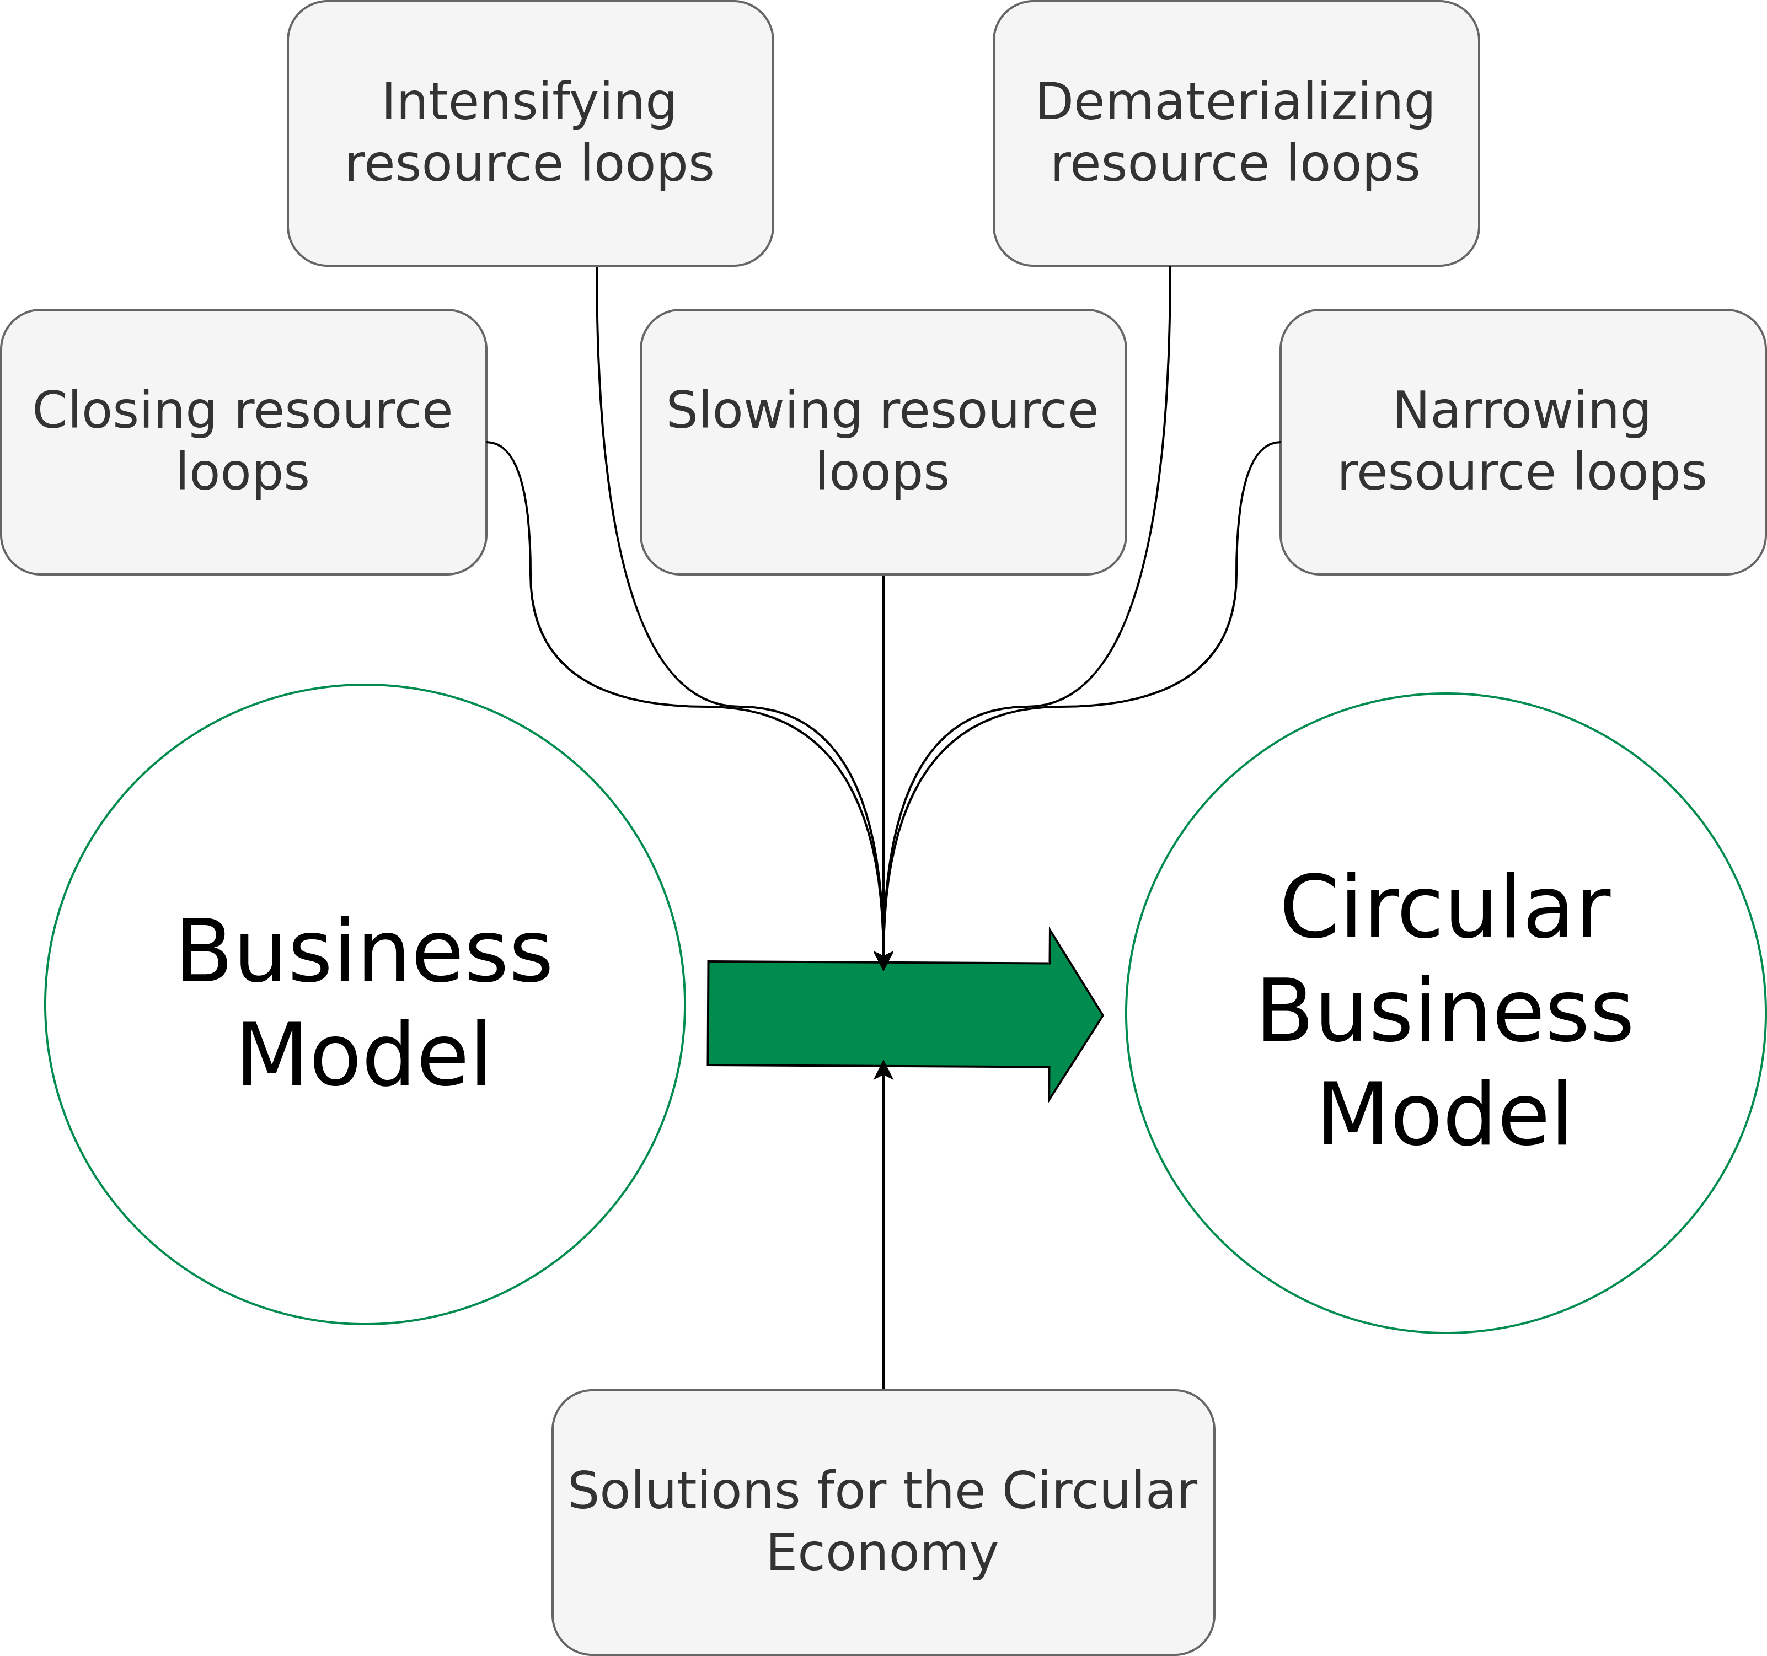
Circular Economy Business Models
Geissdoerfer et al. (2018) – Business models and supply chains for the circular economy.

Slide 50
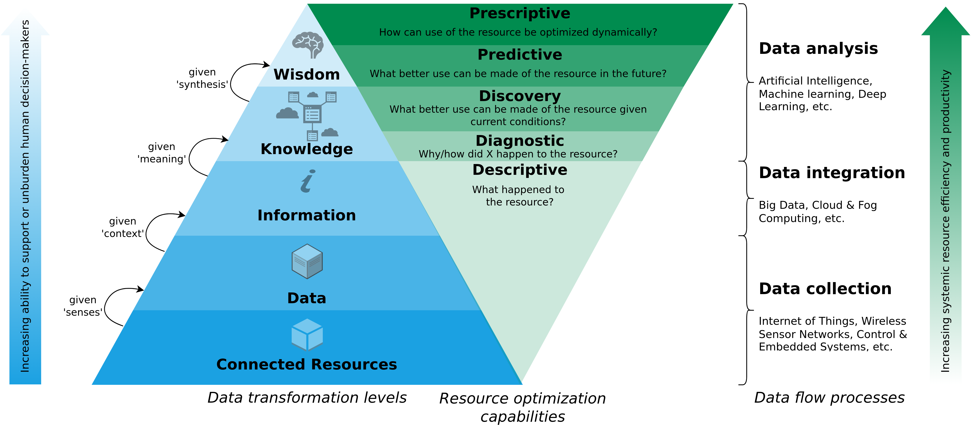
#1: A Data-Driven Smart Circular Economy Framework
Kristoffersen et al. (2020) – The smart circular economy: A digital-enabled circular strategies framework for manufacturing companies.

Slide 51
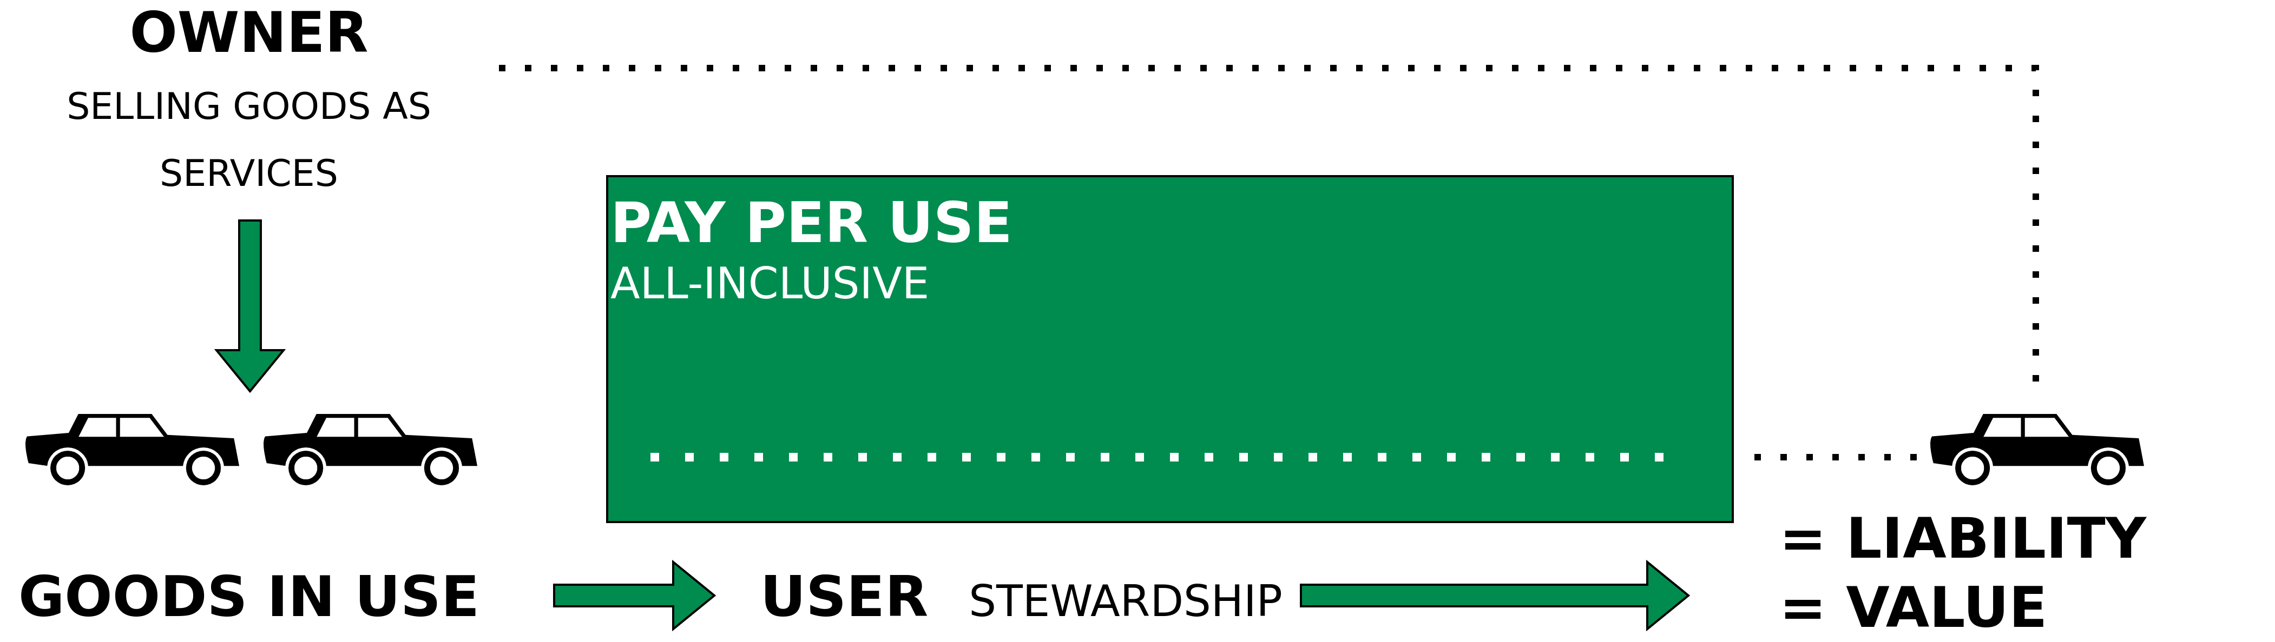
#2: Performance Economy and/to Sharing Economy
Walter R. Stahel (2019) – The Circular Economy: A User’s Guide.

Slide 52
Emerging Technologies for the Circular Economy

Slide 53
The Nature of Technology
In the past many new technologies have emerged and disrupted existing economical models.
Arthur, Brian (2011) – The Nature of Technology: What It Is and How It Evolves.

Slide 54
The Nature of Technology
In the past many new technologies have emerged and disrupted existing economical models.
B. Arthur stipulates that an economy is an expression of its technologies
Arthur, Brian (2011) – The Nature of Technology: What It Is and How It Evolves.

Slide 55
The Nature of Technology
In the past many new technologies have emerged and disrupted existing economical models.
B. Arthur stipulates that an economy is an expression of its technologies
Thus, it can be argued that the current unsatisfying state of the Circular Economy reflects a lack of sufficiently developed technologies that express themselves within the CE.
Or, more precisely – difficulties of the stakeholders in combining the technologies that are required to enable the CE.
Arthur, Brian (2011) – The Nature of Technology: What It Is and How It Evolves.

Slide 56
Further Resources
Baccini et al. (2012) – Metabolism of the Anthroposphere: Analysis, Evaluation, Design
Deutscher Bundestag (1994): Bericht der Enquete-Kommission „Schutz des Menschen und der Umwelt − Bewertungskriterien und Perspektiven für umweltverträgliche Stoffkreisläufe in der Industriegesellschaft“ – Link
Determining the environmental impacts of conventional and alternatively fuelled vehicles through LCA (2020) – European Commission – Link
Polestar (2020) – Life Cycle Assessment – Carbon Footprint of Polestar 2 – Link

Slide 57
Questions?

